Slide 1

Poor Designs in Past Radios
Ignoring Analog path Imbalance
Cosine Tapered Nyquist Pulses
Reduced Excess BW in Shaping Filters
Gaussian Shaped Windows and Filters
Scaling Filter Coefficients to Obtain Unity Pass-Band Gain
Sliding Window Spectrum Analysis with less Than 75% Overlap
Big Signal Capture of AGC in Spectrum Analyzers
Chebyshev Stopband Amplitude Sidelobes
Not Scaling Signal Samples with SNR
Cooley-Tukey FFT Instead of Good-Thomas FFT

Slide 2
Ensemble Average to improve Statistics of Spectral Estimates
Time Varying Spectra
Waterfall Display
Sliding Window Fourier Transform
Short Time Fourier Transform (STFT)
Ensemble Average
Spectrum
2

Slide 3
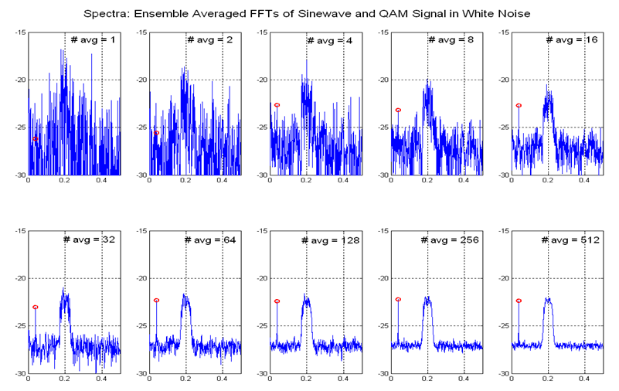
Spectral Estimation in Noise (Need for Ensemble Averaging)
A Consistent Estimator:
It would be nice if when you feed more data to an estimator,
the quality of the estimate doesn’t degrade!

Slide 4
Mean and Standard Deviation same for noise power formed by FFT
Mean and Standard Deviation same for noise power formed by FFT
104

Slide 5
105

Slide 6
106

Slide 7
Power Spectrum Estimation of Random Signals with FFT
Coherent
Average
(6dB/Double)
Incoherent
Average
(3dB/Double)
7

Slide 8
Window to Suppress Boundary Effects
Missing Data

Slide 9
How Much Overlap?

Slide 10
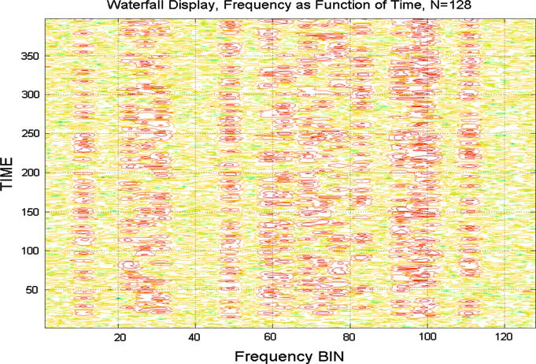

Slide 11
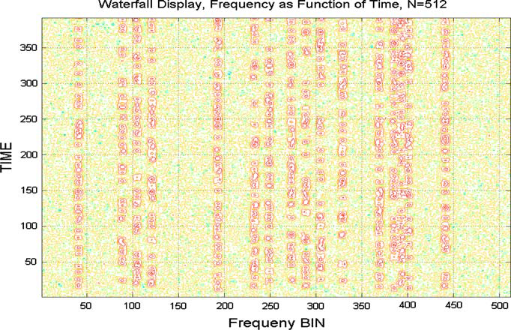
4 Times longer
Same shift of 128

Slide 12
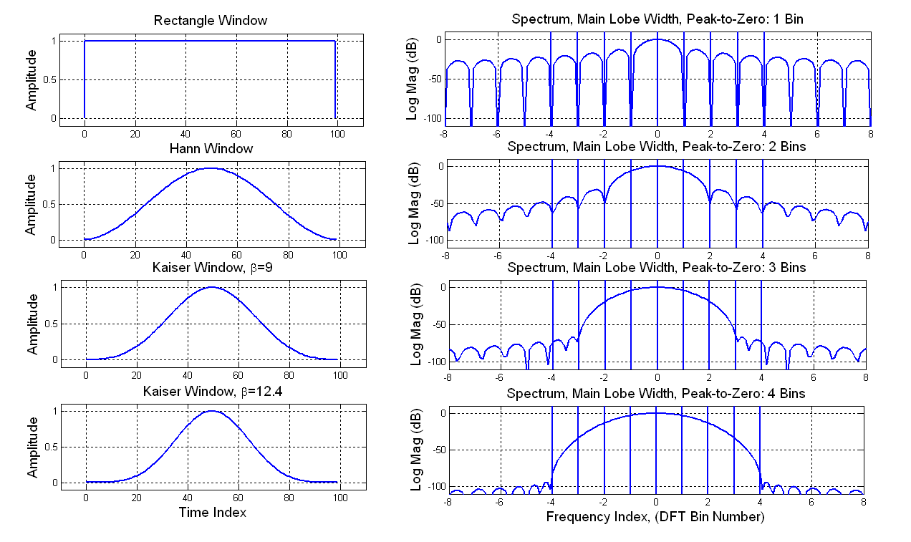
Windows Trade Increased Spectral Main Lobe Width for Reduced Level Spectral Side Lobes

Slide 13
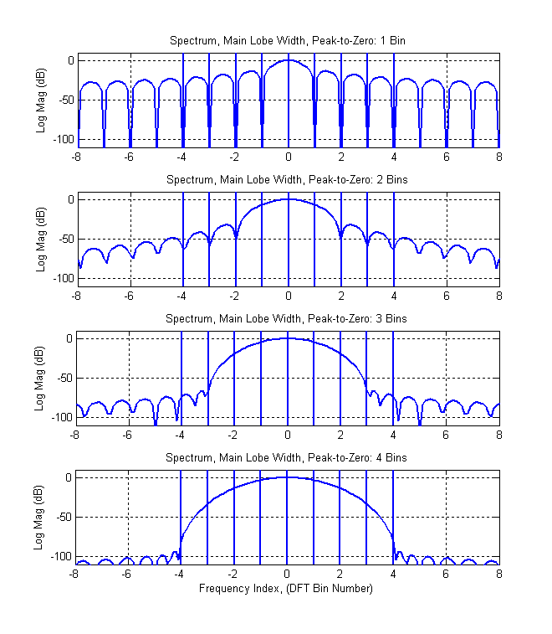
Satisfy Nyquist Criterion, Examine Main Lobe BW
Choose Sample Rate from Mainlobe Bandwidth
Main Lobe BW = fs/N
Nyquist Rate = fs/N (No Overlap)
Perform N-to-1 Down Sample in DFT
Input N-samples, Output 1 Output Sample
Main Lobe BW = 2fs/N fs/N
Nyquist Rate = 2fs/N = fs/(N/2) (50% Overlap)
Perform N-to-2 Down Sample in DFT
Input N/2-samples, Output 1 Output Sample
Main Lobe BW = 3fs/N fs/N
Nyquist Rate = 3fs/N = fs/(N/3) (66.6% Overlap)
Perform N-to-3 Down Sample in DFT
Input N/3-samples, Output 1 Output Sample
Main Lobe BW = 4fs/N
Nyquist Rate = 4fs/N = fs/(N/4) (75% Overlap)
Perform N-to-4 Down Sample in DFT
Input N/4-samples, Output 1 Output Sample

Slide 14
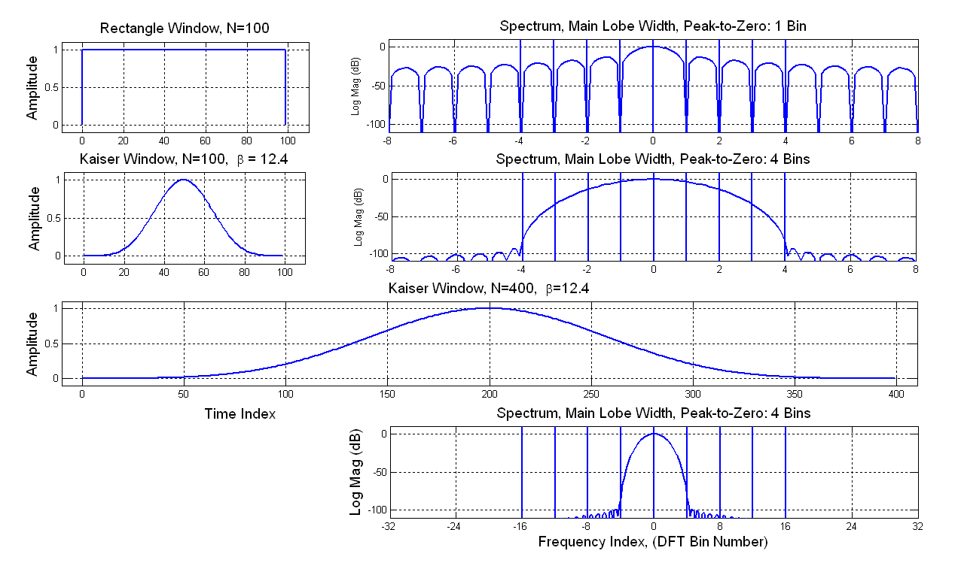
N Point Smooth Window: BW is 4-Times Width of Rectangle Window 4N Point Smooth Window: BW is Equal to Width of Rectangle Window
Bin 4 of 4N Point FFT
is same BW as
Bin 1 of N Point FFT

Slide 15
Successive Non Overlapped Window Intervals of Length N Overlapped Window Intervals of Length 4N, and 4-to-1 Folded (or Aliased) Window Intervals Folded Window is a Polyphase Partition

Slide 16

4-N Point Window Folded 4-to-1 by Poly-Phase Partition as Input to N-Point FFT

Slide 17
RECOMMENDATION
For High Performance Radios
When performing High Dynamic range Spectral analysis
Use Window with sidelobes matched to target dynamic range, say 100 dB, and
Use Sliding Overlapped Windows with 75% overlap
Also Consider using Polyphase 4-to-1 Folding of Extended length Window
To avoid larger transform and highly correlated spectral samples

Slide 18
Poor Designs in Past Radios
Ignoring Analog path Imbalance
Cosine Tapered Nyquist Pulses
Reduced Excess BW in Shaping Filters
Gaussian Shaped Windows and Filters
Scaling Filter Coefficients to Obtain Unity Pass-Band Gain
Sliding Window Spectrum Analysis with less Than 75% Overlap
Big Signal Capture of AGC in Spectrum Analyzers
Chebyshev Stopband Amplitude Sidelobes
Not Scaling Signal Samples with SNR
Cooley-Tukey FFT Instead of Good-Thomas FFT
117

Slide 19
2’s Complement Arithmetic; DC Bias

Slide 20
Algorithmic (Arithmetic) Noise Sources: Scaling of Processing Gain, Scaling of Products, and Quantized Coefficients

Slide 21
16-Point Radix-2 Rearrangement In Time Cooley-Tukey FFT

Slide 22
Frequency Dependent Noise of FFT Algorithm

Slide 23
Effect of Scaling on Dynamic Range of FFT

Slide 24
Poor Designs in Past Radios
Ignoring Analog path Imbalance
Cosine Tapered Nyquist Pulses
Reduced Excess BW in Shaping Filters
Gaussian Shaped Windows and Filters
Scaling Filter Coefficients to Obtain Unity Pass-Band Gain
Sliding Window Spectrum Analysis with less Than 75% Overlap
Big Signal Capture of AGC in Spectrum Analyzers
Chebyshev Stopband Amplitude Sidelobes
Not Scaling Signal Samples with SNR
Cooley-Tukey FFT Instead of Good-Thomas FFT
117

Slide 25
When Filter Reduces Bandwidth System Should Reduce Sample Rate
f_{S}
f_{S}
f_{S}
M
Nyquist Sample Rate: f_{S} > 2 sided BW… This not a specification
fred’s Corollary: f_{S} =2 sided BW + Δf … This is a specification,
Δf = Transition BW of Anti-Aliasing Filter
118

Slide 26
Out-of-Band Spectral Side Lobe Levels and Side-Lobe Folding into Passband Due to Sample Rate Reduction
119

Slide 27
Don’t Use Equal Ripple Stop Band! Even Though it is Optimum in the Chebyshev Sense (Not Good for System Performance)
120

Slide 28
RECOMMENDATION
For High Performance Radios
Don’t use the Remez filter design package with equal-ripple stopband sidelobes.
Use Modified penalty function in Remez algorithm that supports
1/f or 1/f ² side-lobe fall-off rate
Contact author for the modified forms of the Remez Penalty Function

Slide 29
Poor Designs in Past Radios
Ignoring Analog path Imbalance
Cosine Tapered Nyquist Pulses
Reduced Excess BW in Shaping Filters
Gaussian Shaped Windows and Filters
Scaling Filter Coefficients to Obtain Unity Pass-Band Gain
Sliding Window Spectrum Analysis with less Than 75% Overlap
Big Signal Capture of AGC in Spectrum Analyzers
Chebyshev Stopband Amplitude Sidelobes
Not Scaling Signal Samples with SNR
Cooley-Tukey FFT Instead of Good-Thomas FFT
121

Slide 30
Estimate Amplitude of Transmitted Signal from Received Signal
122

Slide 31
Decision Aided Acquisition
123
Loop Filter needs SNR qualifier

Slide 32
BPSK Phase Error
Consider x(n) y(n)
124

Slide 33
BPSK Phase Error
Low SNR Phase Estimate
Down Converted
Modulation Component
With Carrier Phase Error
Option 1: x(n) y(n)
Phase
Error
BPSK Slicer Output.
Estimate of
Modulation Component
High SNR Phase Estimate
Option 2: sgn(x(n)) y(n)
125

Slide 34
Phase Detectors for Modulated BPSK
The sgn(x) is a
Decision.
Decisions are
Not to be Trusted
at Low SNR
126
No Multiplies in sgn(x)⋅y

Slide 35
Phase Detectors for Modulated QPSK
127
No Multiplies in sgn(x)⋅y-sgn(y)⋅x
No Multiplies in Frequency Estimator (NOT Optimum)

Slide 36
128

Slide 37
QPSK S-Curve as Function of SNR
129

Slide 38
SNR Used by all Adaptive Loops and Estimators

Slide 39
BPSK Large SNR Approximation to ML
131

Slide 40
BPSK Large SNR Approximation to ML
132

Slide 41
BPSK ML Carrier Recovery Loop
133

Slide 42
BPSK ML Carrier Recovery Loop
134

Slide 43
BPSK Large SNR Approximation to ML
135

Slide 44
BPSK Large SNR Approximation to ML
136

Slide 45
BPSK ML Carrier Recovery Loop
137

Slide 46
BPSK ML Carrier Recovery Loop
138

Slide 47
RECOMMENDATION
Always operate a background SNR estimator to
Estimate SNR per symbol that will qualify goodness of data samples
that contribute to every averaging
Process in Timing Recovery, Carrier Recovery, Phase Recovery,
Equalizers, and AGC loops.
SNR per data sample is required for optimal Maximum Likelihood estimators

Slide 48
Poor Designs in Past Radios
Ignoring Analog path Imbalance
Cosine Tapered Nyquist Pulses
Reduced Excess BW in Shaping Filters
Gaussian Shaped Windows and Filters
Scaling Filter Coefficients to Obtain Unity Pass-Band Gain
Sliding Window Spectrum Analysis with less Than 75% Overlap
Big Signal Capture of AGC in Spectrum Analyzers
Chebyshev Stopband Amplitude Sidelobes
Not Scaling Signal Samples with SNR
Cooley-Tukey FFT Instead of Good-Thomas FFT

Slide 49
Phobia Glossary (from the Los Angeles Times) Authorities say a seemingly endless variety of objects or phenomenon can trigger phobias. Most of them – like fear of heights, or fear of water – do not incapacitate an individual. Others do. Some phobias are unique to individuals; most others have appeared frequently enough to have been given a name. Below is a list of medically recognized phobias, with their Latin or Greek names presented first, followed by their English translation.
ARACHNEPHOBIA - Fear of Spiders.
AMAXOPHOBIA or HAMAXOPHOBIA –
Fear of vehicles.
ANDROPHOBIA – Fear of Males.
AUTOPHOBIA – Fear of Self.
AUTOMYSOPHOBIA – Fear of being dirty.
BELONEPHOBIA – Fear of pins.
BROMIDOSIPHOBIA or
OSPHRESIOPHOBIA or OSMOPHOBIA – Fear of odors.
CYNOPHOBIA – Fear of dogs.
ENTOMOPHOBIA – Fear of Insects.
ERGASIOPHOBIA or PONOPHOBIA –
Fear of work.
GAMOPHOBIA – Fear of marriage.
GEPHYROPHOBIA – Fear of crossing a bridge.
GRAPHOPHOBIA – Fear of writing.
GYNEPHOBIA – Fear of women.
HELIOPHOBIA – Fear of sun.
HODCPHOBIA – Fear of traveling.
HYGROPHOBIA – Fear of dampness.
HYPNOPHOBIA – Fear of sleep.
ICHTHYOPHOBIA – Fear of fish.
MYSOPHOBIA or RHYPOPHOBIA –Fear of dirt.
OMBROPHOBIA – Fear of rain.
PANPHOBIA – Fear of everything.
PENIAPHOBIA – Fear of poverty.
PHARMACOPHOBIA – Fear of drugs.
PHOBOPHOBIA – Fear of phobias.
SIDERODROMOPHONIA – Fear of trains.
SPECTRAPHOBIA –
Fear of Fourier Transforms.
VACCINOPHOBIA – Fear of vaccination.

Slide 50
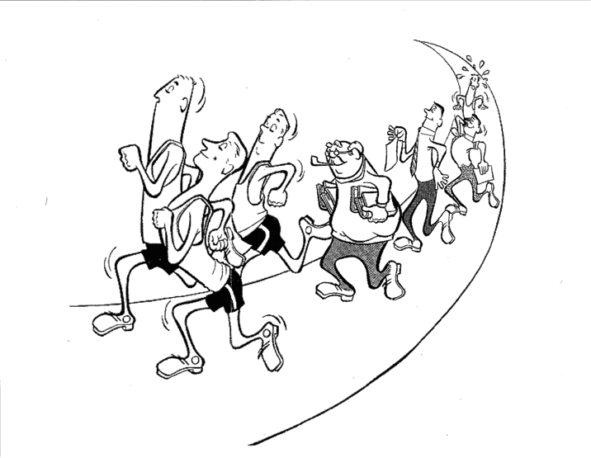
The Transform
Good-Thomas
Transform
Cooley-Tukey
Transform
Bluestein
Algorithm
DFT
Rader
Algorithm
Number Theoretic Transform
FFT
FFT
A Collection of
Algorithms
Winograd
Transform
A Family Portrait
50
Fourier Transform Algorithms

Slide 51
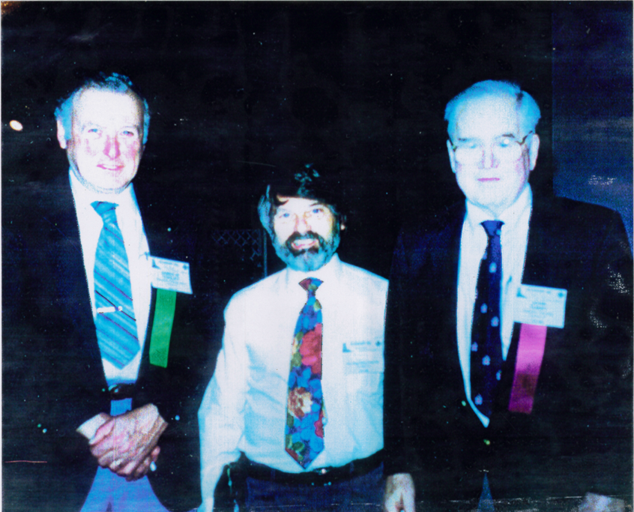
James Cooley, fred harris, John Tukey
1992 ICASSP Conference, San Francisco, Plenary Talk
25-th Anniversary of CT-FFT (1965)
James Cooley, fred harris, John Tukey
1992 ICASSP Conference, San Francisco,
Plenary Talk, 25-th Anniversary of CT-FFT
Special issue on fast Fourier transform and its application to digital filtering and spectral analysis, IEEE Trans. Audio Electronics (1967), AU-15
http://www.ieeeghn.org/wiki/index.php/Archives:History_of_FFT_with_Cooley_and_Tukey
Notes:
Special issue on fast fourier transform and its application to digital filtering and spectral analysis, IEEE tran. Audio Electronics (1967), AU-15

Slide 52
FFT-TREE

Slide 53
Inverse Fourier Transform
Synthesis

Slide 54
The Fourier Transform
Analysis
The word Orthogonal
Is used a lot around here!

Slide 55
Cascade Inverse and Forward Fourier Transforms
Synthesis
Analysis
OFDM

Slide 56
Cascade Forward and Inverse Fourier Transforms
Analysis
Synthesis
MPEG, MP3

Slide 57
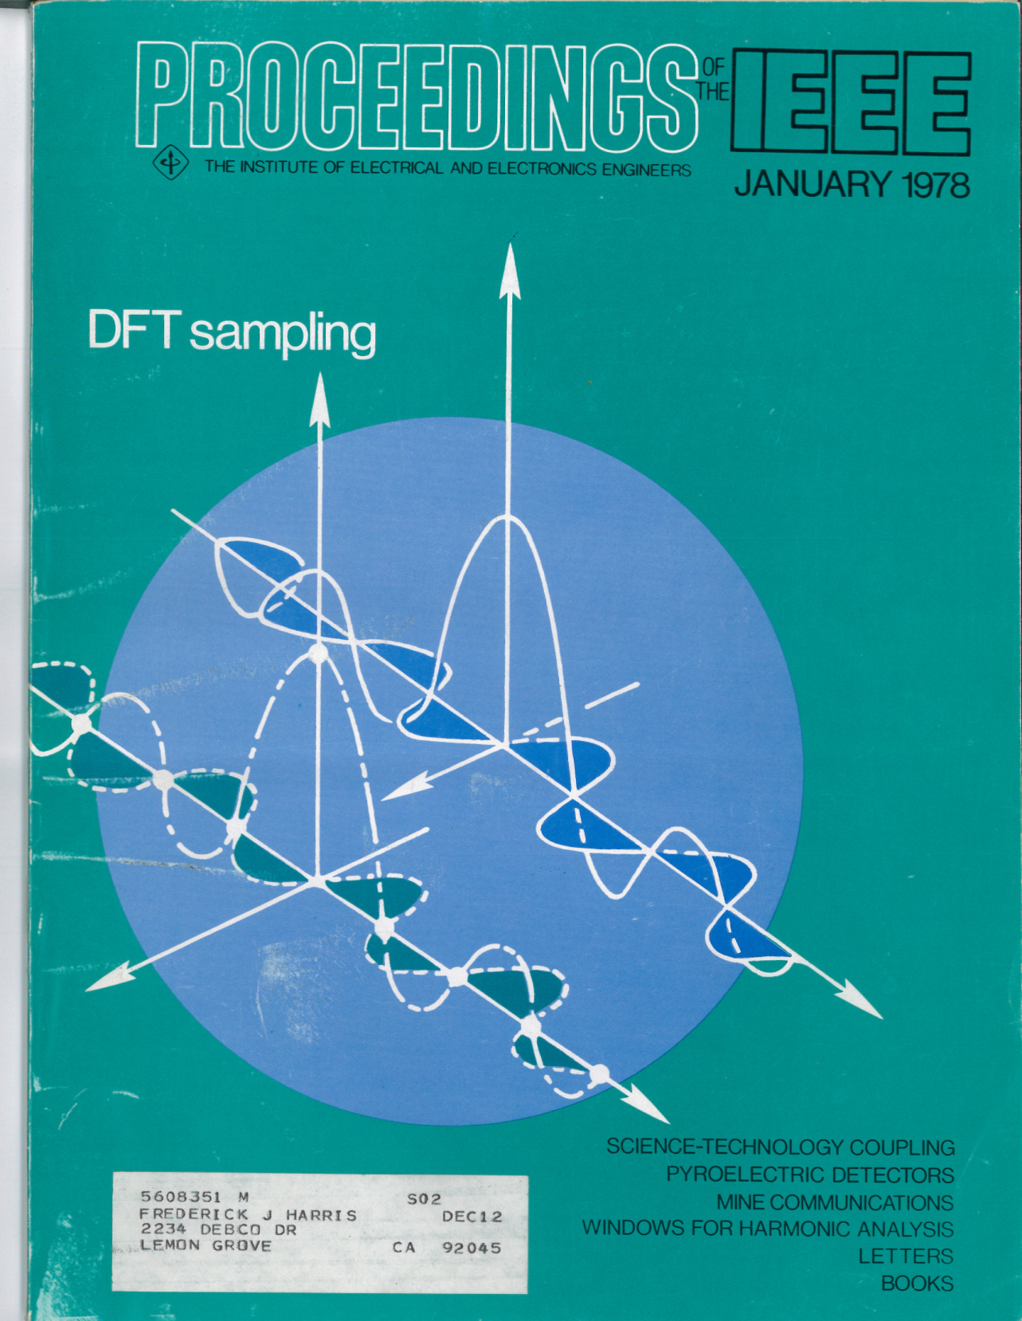

Slide 58
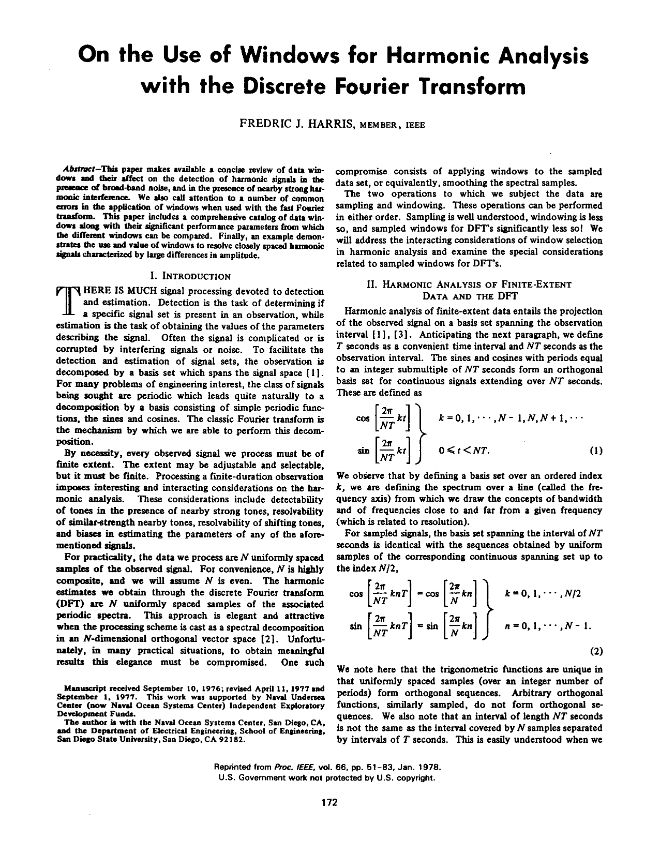
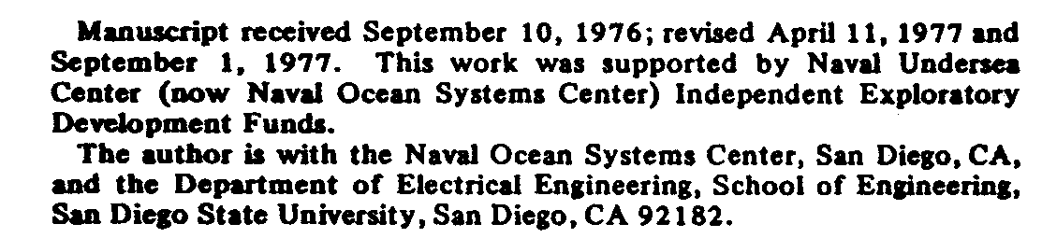

Slide 59
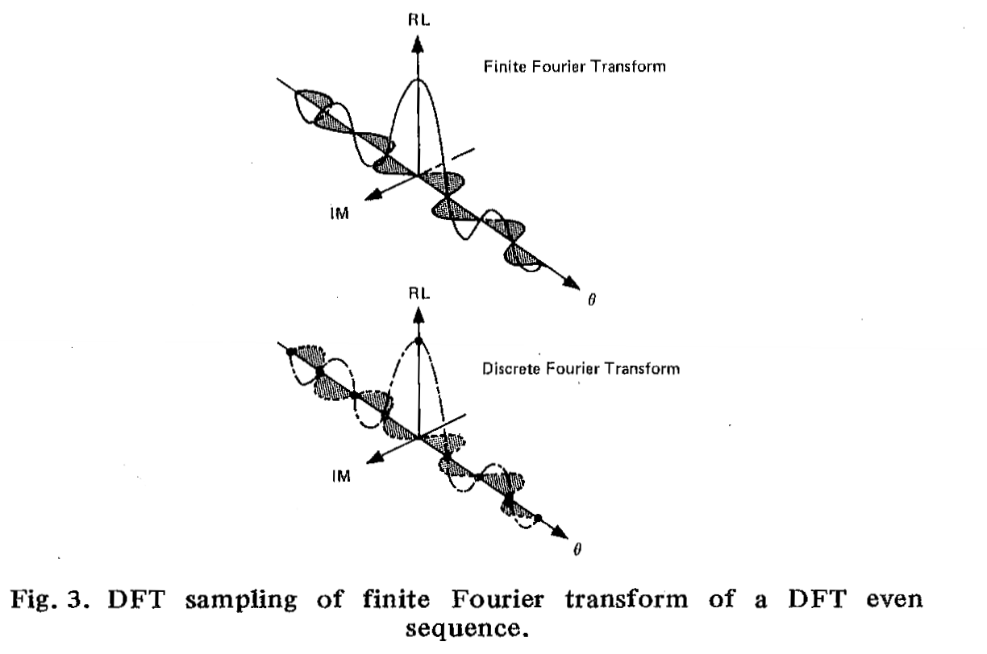

Slide 60
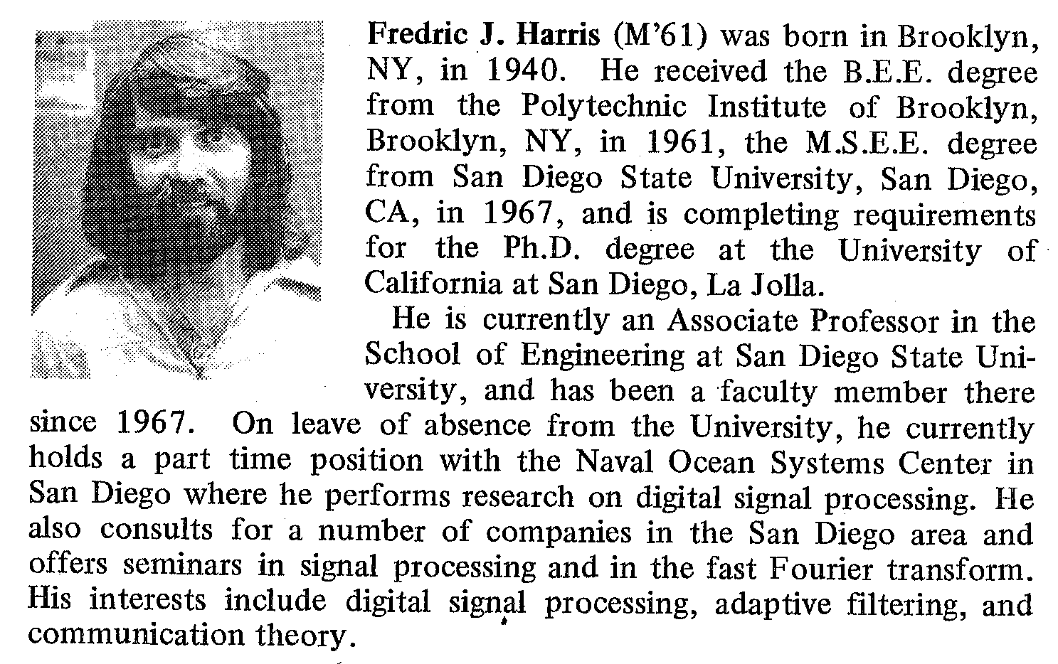

Slide 61
Zero-Packed Data Has Replica Spectra
x(n)
X(k)
Primary Nyquist Zone
x(n), Zero Packed 1-to-3
3-Replica Nyquist Zones

Slide 62
Cooley-Tukey Index Mapping
Perform 3-to-1 Down Sample in Time to Alias Spectral Copies to a Single Copy
Loading array by columns
advances time origin. There is need for frequency domain phase rotation to delay origin back to its initial location!
Need twiddle factors.
Need Trig tables.
Need complex arithmetic.

Slide 63
Lexicographic (In Natural Order) Mapping
Transform by Rows
Twiddle Rows
Transform by Columns
Load by Columns
Unload by Rows

Slide 64
Replica Spectra of Zero-Packed Data: Perform 3-to-1 Down-Sample of Spectrum to Alias Zero-Packed Time Series
Earlier We Aliased the Spectral Copies by
3-to-1 Down-Sample of the Time Series
Here We take a Different Tack:
We 3-to-1 Down-Sample the Spectral Copies
and Alias the Zero-packed Time Samples

Slide 65

Good-Thomas Index Mapping
Loading array by Bishop’s
tour does not advance time
origin. There is no need for
frequency domain phase
rotation to delay origin back
to its initial location!
No twiddle factors.
No Trig tables.
No complex arithmetic.
Good-Thomas
As opposed to
Odd-Thomas

Slide 66
Residue Input (Chinese Remainder Theorem) Mapping, Some other Theorem Output Mapping
Load by
Bishop’s Tour
Unload by
Knight’s Tour

Slide 67
Comparison of FFT Algorithms (Complex Input Data)
Good-Thomas, Winograd FFT
Radix-2 Cooley-Tukey FFT
Block length | Factors | Real Mult | Real Adds | Block Length | Real Mult | Real Adds
30 | 2x3x5 | 72 | 384 | 32 | 320 | 480
48 | 3x16 | 92 | 636
60 | 3x4x5 | 144 | 888 | 64 | 768 | 1,152
91 | 7x13 | 318 | 2,648
120 | 3x5x8 | 288 | 2,076 | 128 | 1,792 | 2,688
168 | 3x7x8 | 432 | 3,492
240 | 3x5x16 | 648 | 5,012 | 256 | 4,096 | 6,144
420 | 3x4x5x7 | 1,296 | 11,352
504 | 7x8x9 | 1,584 | 14,642 | 512 | 9,216 | 6,144
840 | 3x5x7x8 | 2,592 | 24,804
1,008 | 7x9x16 | 3,564 | 34,920 | 1,024 | 20,480 | 30,720
2,520 | 5x7x8x9 | 9,504 | 100,188 | 2,048 | 45,056 | 67,584
10,920 | 3 x5x7x8x13 | 38,760 | 320,196 | 8,192 | 212,992 | 319,488
No Trig Table or Twiddle Factors
N/2 Point Trig Table
(N/2)log₂(N) Complex Twiddle Factors
<4N Real Multiplies

Slide 68
2²⁵=(2¹³)(2¹²)=33,554,432 Point FFT
AMDAHL
Jodrell Bank
Minor Problem:
It Didn’t Work!

Slide 69
35,225,190 Point FFT
Prime-Factor FFT, No Trig Table
Short FFT
Algorithms
Trig Table
87 Values
Short Winograd
FFT Algorithms

Slide 70
RECOMMENDATION
Consider Use of the Good-Thomas (Prime-Factor) Fast Fourier Transforms
With embedded Winograd Short FFT Algorithms
As Opposed to the ubiquitous Cooley-Tukey FFT algorithm.
You will save machine cycles, memory, and power.
Particularly important in battery operated equipment

Slide 71
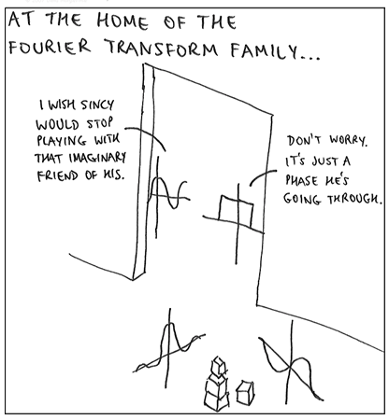

Slide 73
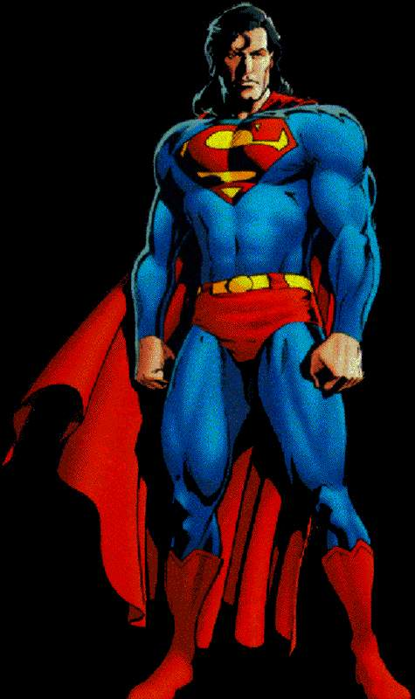
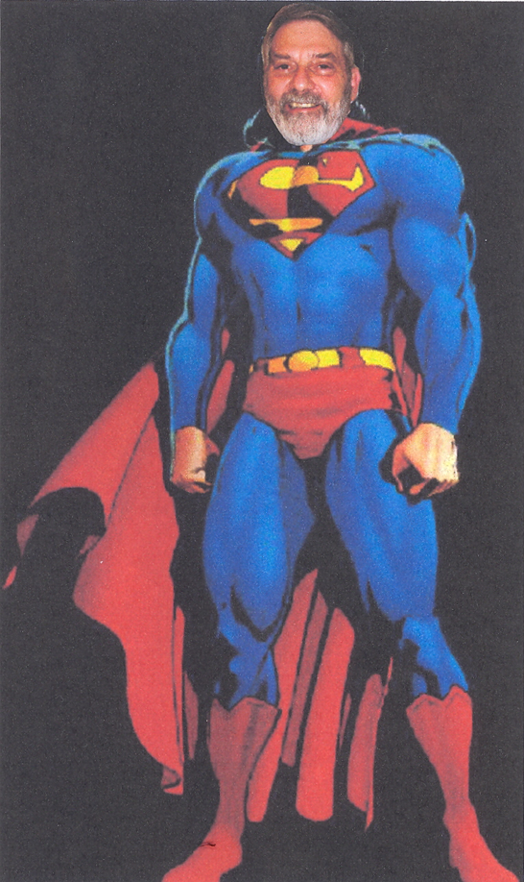

SOFTWARE
DEFINED
RADIO
MAN
Is Open For Questions

